Slide 1


Introduction To
Data Science
Multiple Linear Regression
“Hiding within those mounds of data is the knowledge that could change the life of a patient, or change the world”

Slide 2

Multiple linear regression
Multiple Linear Regression
Predicting the values of a continuous variable

Slide 3
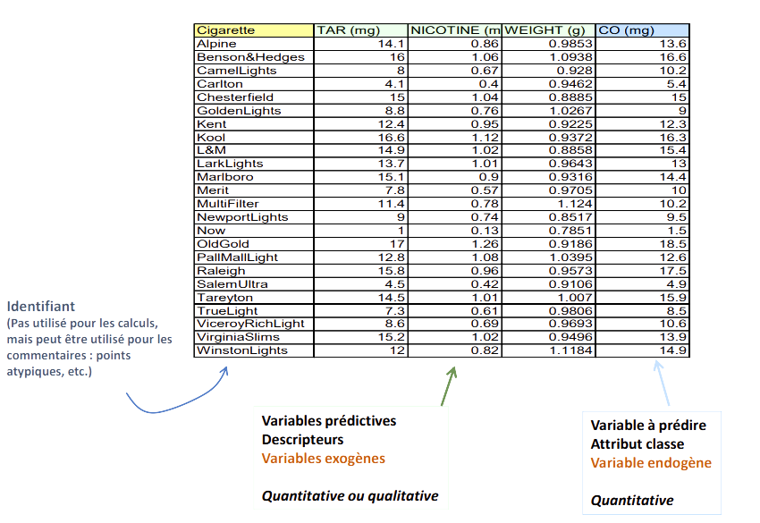
Data table and status of variables
Multiple Linear Regression
Identifier (Not used for calculations, but can be used for comments: atypical points, etc.)
Predictive variables Descriptors Exogenous variables Quantitative or qualitative
Variable to be predicted Class attribute Endogenous variable Quantitative

Slide 4
The general linear model
Multiple Linear Regression

Slide 5
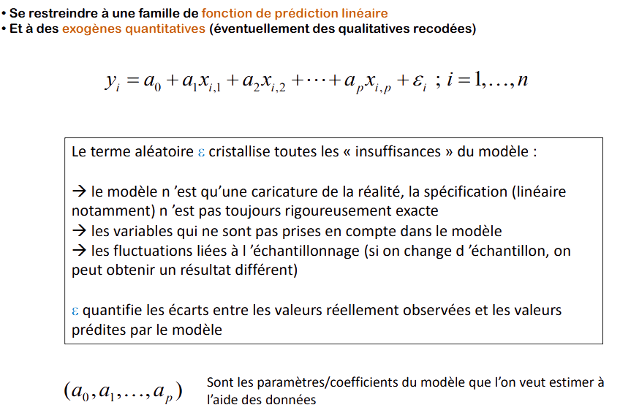
Data table and status of variables
Multiple Linear Regression
- Restrict to a family of linear prediction functions
- And to quantitative exogenous (possibly recoded qualitative)
The term "random" crystallizes all the "inadequacies" of the model:
→ the model is only a caricature of reality, the specification (linear in particular) is not always rigorously exact
→ the variables that are not taken into account in the model
→ fluctuations linked to sampling (if we change the sample, we can obtain a different result)
ε quantifies the differences between the values actually observed and the values predicted by the model
Are the parameters/coefficients of the model that we want to estimate with using the data

Slide 6
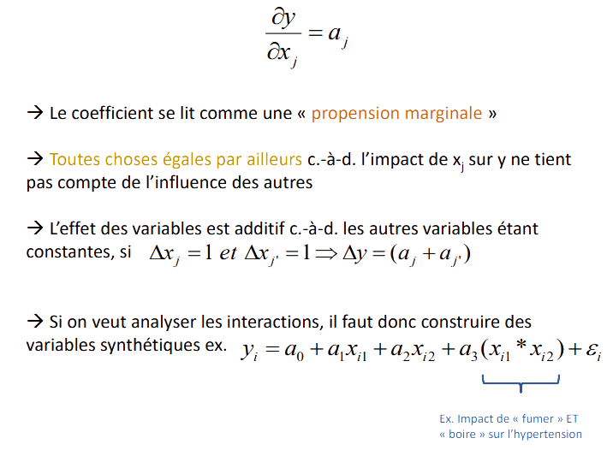
Data table and status of variables
Multiple Linear Regression
→ The coefficient is read as a "marginal propensity".
→ All else being equal, i.e., the impact of xj on y does not take into account the influence of other
→ The effect of the variables is additive, i.e., the other variables being constant, if constant, if
→ If we want to analyse the interactions, we must therefore construct synthetic
synthetic variables, e.g.
Ex. Impact of "smoking" AND "drinking
"drinking" on hypertension

Slide 7
Multiple linear regression Modelling approach
Multiple Linear Regression
The modelling approach is always the same
estimate the "a" parameters by exploiting the data
evaluate the precision of these estimators (bias, variance, convergence)
measure the overall explanatory power of the model
evaluate the influence of the variables in the model
globally (all p variables)
individually (each variable)
a block of variables (q variables, q ≤ p) [this is a generalization]
select the most "relevant" variables
evaluate the quality of the model during prediction (prediction interval)
detect observations that may distort or overly influence the results (atypical results (atypical points).

Slide 8
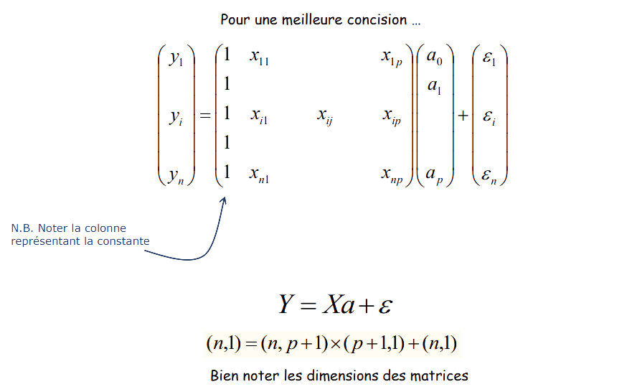
Multiple linear regression Matrix writing
Multiple Linear Regression
For a better concision ...
P.S. Note the column
representing the constant
Note the dimensions of the matrices

Slide 9
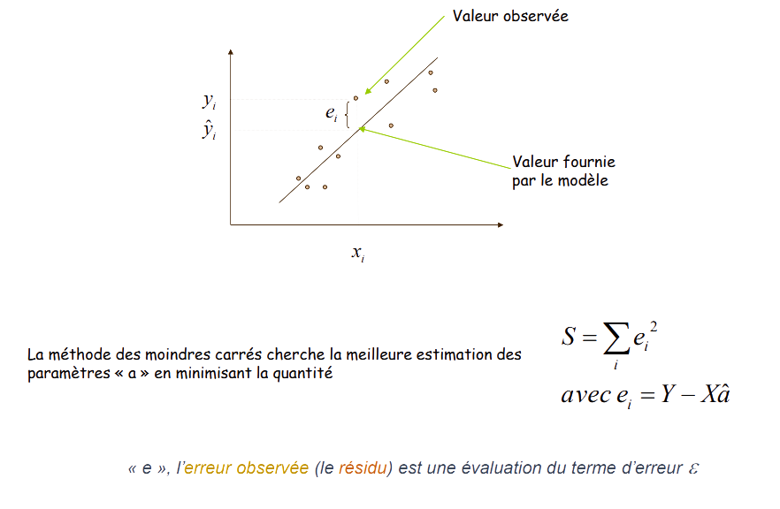
The method of least squares
Multiple Linear Regression
Observed value
Value provided
by the model
The least squares method seeks the best estimate of the parameters "a" by minimizing the quantity
With
"e", the observed error (the residual) is an evaluation of the error term ε

Slide 10
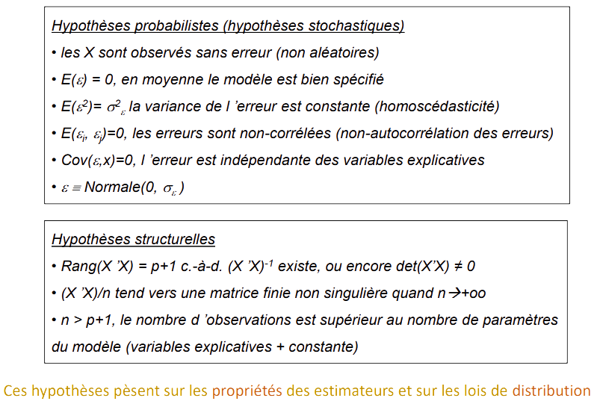
The assumptions of the OLS method "â" become OLS (ordinary least squares estimators)
Multiple Linear Regression
Probabilistic assumptions (stochastic assumptions)
the Xs are observed without error (not random)
E(ε) = 0, on average the model is well specified
E(ε²) = σ²ε the variance of the error is constant (homoscedasticity)
E(εi, εj)=0, the errors are uncorrelated (non autocorrelation of the errors)
Cov(ε, x)=0, the error is independent of the explanatory variables
ε Normal(0, σε)
Structural assumptions
Rank(X 'X) = p+1 i.e. (X 'X)-1 exists, or det(X'X) ≠ 0
(X 'X)/n tends to a finite non-singular matrix when n → (+inf)
n > p+1, the number of observations is greater than the number of model parameters (explanatory variables + constant)
These assumptions affect the properties of the estimators and the distribution laws

Slide 11
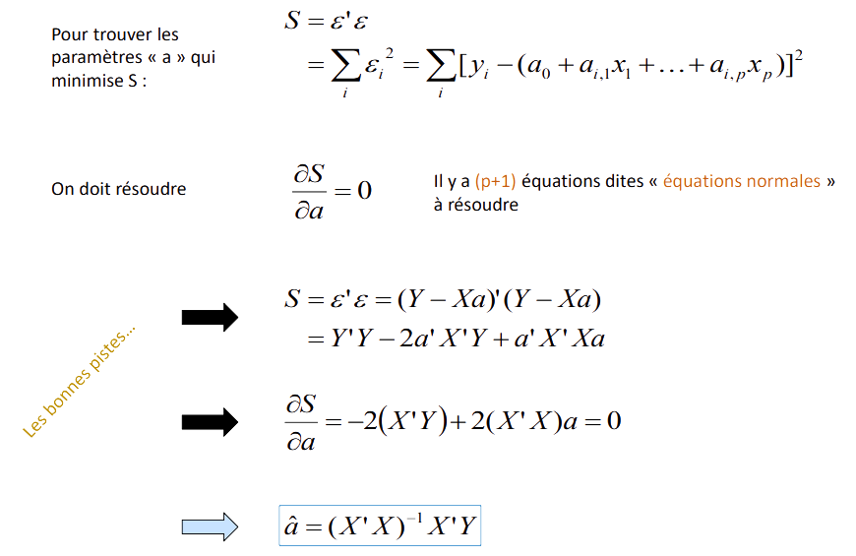
OLS (Ordinary Least Squares Estimator) Calculation principle - Estimator
Multiple Linear Regression
There are (p+1) equations called "normal equations” to solve
We Have to solve
The right tracks

Slide 12
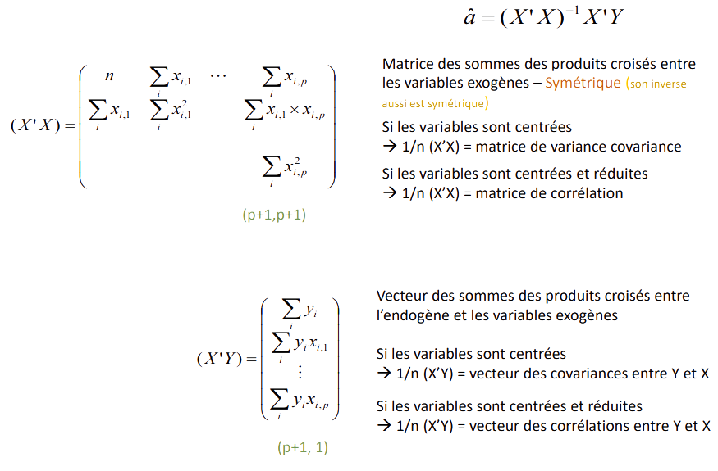
OLS (Ordinary Least Squares Estimator) Comments
Multiple Linear Regression
Matrix of sums of cross products between exogenous variables - Symmetric (its inverse is also is also symmetric)
If the variables are centred
→ 1/n (X'X) = variance covariance matrix If the variables are centred and reduced
→ 1/n (X'X) = correlation matrix
Vector of the sums of the cross products between the endogenous and the exogenous variables If the variables are centred
→ 1/n (X'Y) = vector of covariances between Y and X If the variables are centred and reduced
→ 1/n (X'Y) = vector of correlations between Y and X

Slide 13
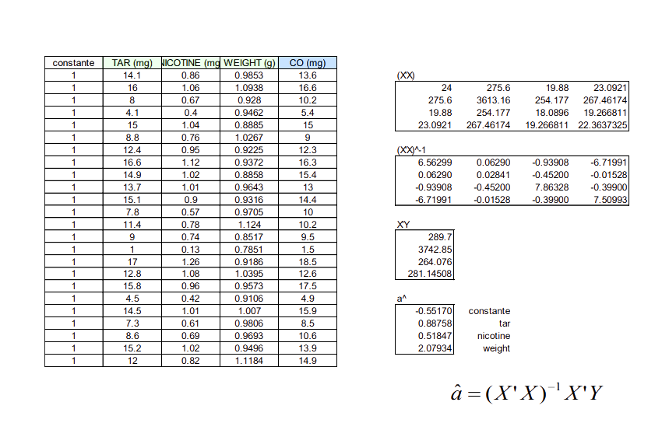
OLS (Ordinary Least Squares Estimator) In the EXCEL Table
Multiple Linear Regression
Vector of the sums of the cross products between the endogenous and the exogenous variables If the variables are centred
→ 1/n (X'Y) = vector of covariances between Y and X If the variables are centred and reduced
→ 1/n (X'Y) = vector of correlations between Y and X

Slide 14
Properties and estimators
Multiple Linear Regression

Slide 15
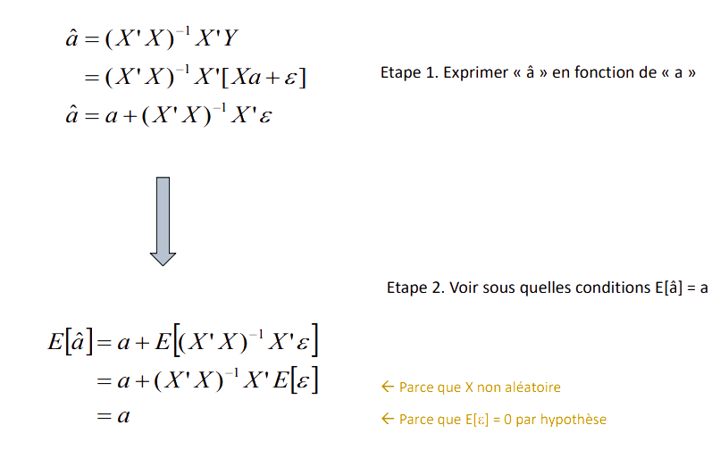
Bias of "â”
Multiple Linear Regression
Step 1. Express "â" as a function of "a"
Step 2. See under which conditions E[â] = a
<- Because X is not random
<- Because E[ε] = 0 by hypothesis

Slide 16
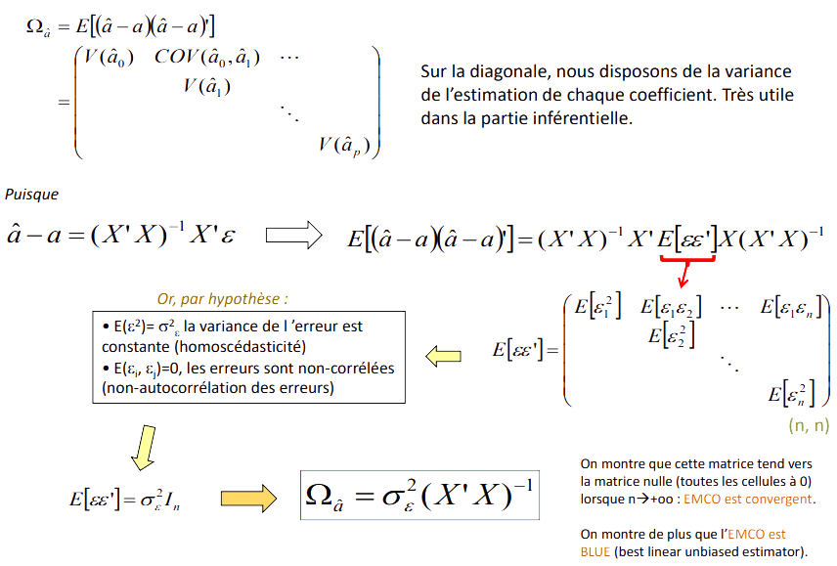
Variance covariance matrix of "â"
Multiple Linear Regression
On the diagonal, we have the variance of the estimate of each coefficient. Very useful in the inferential part.
Since
Now, by hypothesis :
E(ε²) =σ²ε the variance of the error is constant (homoscedasticity)
E(εi, εj )=0, the errors are uncorrelated (non-autocorrelation of errors)
We show that this matrix tends to the null matrix (all cells at 0) when n → (+inf): EMCO is convergent.
We also show that the EMCO is BLUE (best linear unbiased estimator).

Slide 17
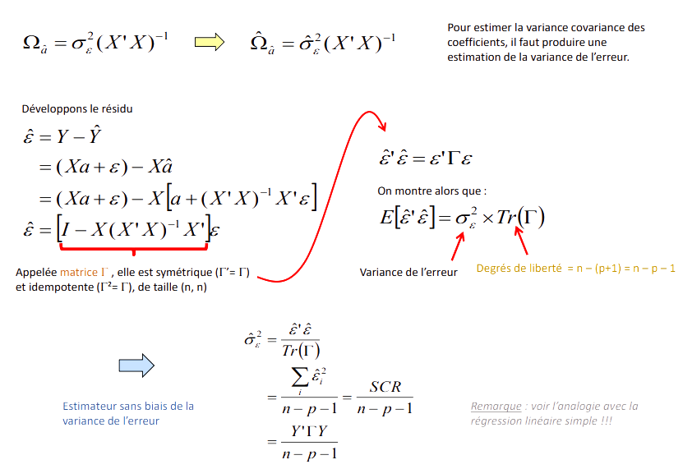
Variance of the error
Multiple Linear Regression
To estimate the variance covariance of the coefficients, it is necessary to produce an estimate of the variance of the error.
Let's develop the residue
We show that
Called matrix , it is symmetric (Γ‘=Γ) and idempotent (Γ ²= Γ), of size (n, n)
Variance of the error
Degrees of freedom = n - (p+1) = n - p - 1
Estimateur non biaisé de la variance de l'erreur
Note: see the analogy with the simple linear regression !!!

Slide 18
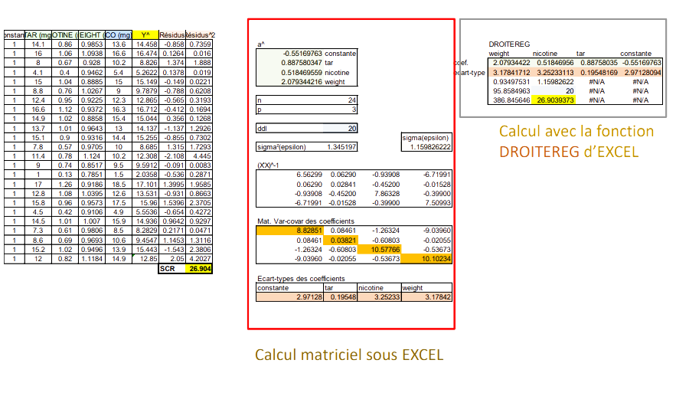
Calculations in Excel
Simple Linear Regression
Calculation with the function DROITEREG of EXCEL
Standard deviations of coefficients
Matrix calculation in EXCEL

Slide 19
statistical inference on the coefficients
Multiple Linear Regression

Slide 20
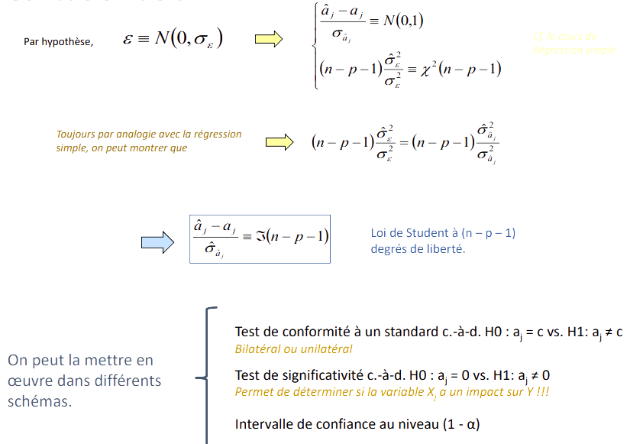
Distribution of â
Multiple Linear Regression
By hypothesis,
See the course on Simple regression
Still by analogy with the simple regression we can show that
Student's law with (n - p - 1) degrees of freedom.
Test of conformity to a standard i.e., H0: aj = c vs. H1: aj ≠ c
Two-sided or one-sided
Significance test i.e., H0: aj = 0 vs. H1: aj ≠ 0
Determines if the variable Xj has an impact on Y!!!
Confidence interval at the (1 - α) level
It can be implemented in implemented in different schemes.

Slide 21
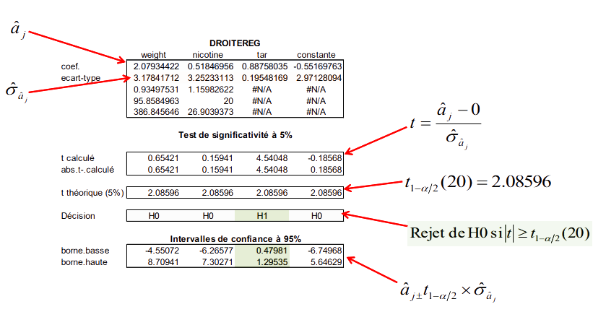
Example of cigarettes
Multiple Linear Regression
Significance test at 5% level
t calculated
abs.t-.calculated
t theoretical (5%)
Decision
By hypothesis
Rejection of H0 if
low. Terminal
high. Bound

Slide 22

overall evaluation of the regression
Multiple Linear Regression

Slide 23
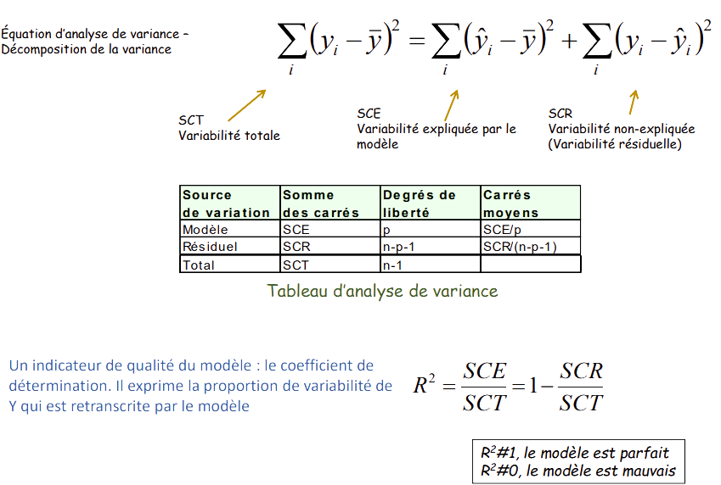
Overall evaluation of the regression Analysis of variance table and coefficient of determination
Multiple Linear Regression
Analysis of variance equation - Variance decomposition
SCT Total variability
SCE Variability explained by the model
SCR Unexplained variability (Residual variability)
Analysis of variance table
An indicator of model quality: the coefficient of determination. It expresses the proportion of variability of Y that is transcribed by the model
R²#1, the model is perfect
R²#0, the model is bad

Slide 24
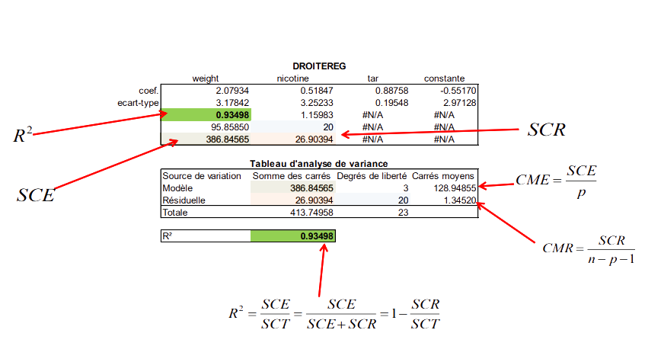
Example of cigarettes
Multiple Linear Regression
coef.
standard deviation
Analysis of variance table
Source of variation Sum of squares Degrees of freedom Mean squares
Model
Residual

Slide 25
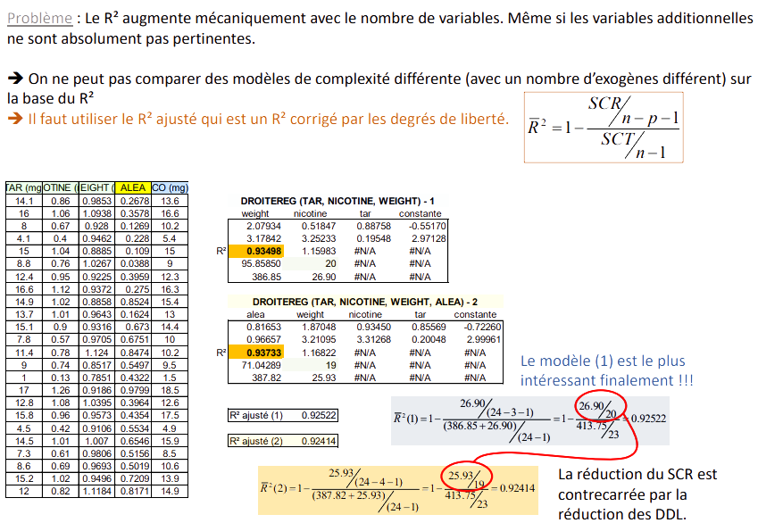
R² corrected for overfitting
Multiple Linear Regression
Problem: The R² increases mechanically with the number of variables. Even if the additional variables are completely irrelevant.
→ One cannot compare models of different complexity (with a different number of exogenous
-
factors) on the basis of the R²
→ You have to use the adjusted R² which is an R² corrected by the degrees of freedom
The model (1) is the most interesting in the end !!!
The reduction in the SCR is countered by the reduction in DDLs

Slide 26
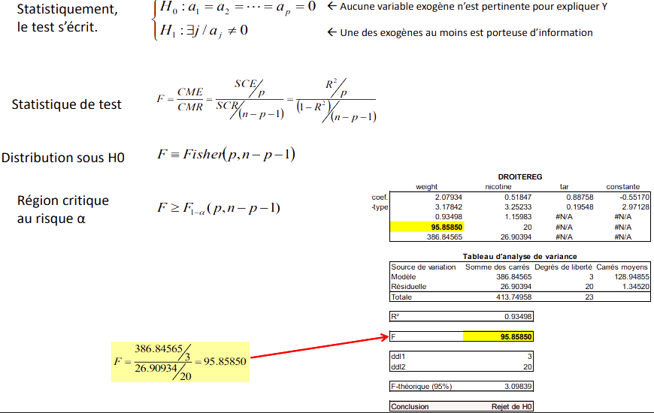
Overall evaluation of the regression Do X's carry information about Y?
Multiple Linear Regression
Statistically,
the test is written.
No exogenous variable is relevant to explain Y
At least one of the exogenous variables carries information
Test statistics
Distribution under H0
Critical region at risk α
Source of variation Sum of squares Degrees of freedom Mean squares
Model
Residual

Slide 27
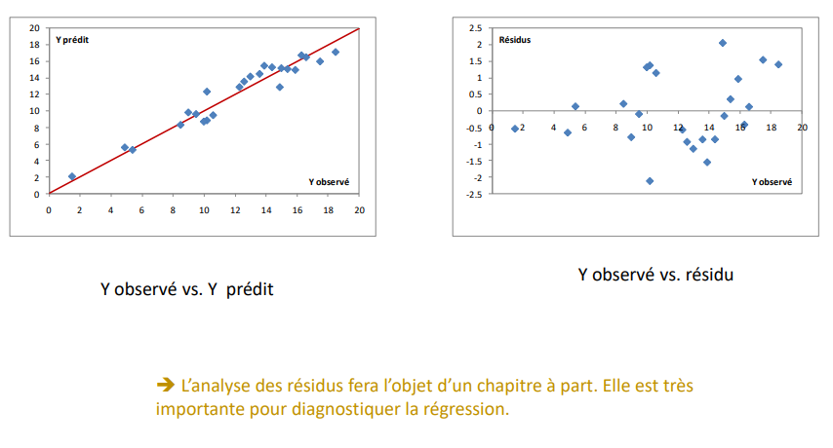
Graphical diagnosis Evaluate the quality of the prediction - Detect pathological cases
Multiple Linear Regression
Observed Y vs. predicted Y
Y observed vs. residual
➔ The analysis of residuals will be the subject of a separate chapter. It is very important to important to diagnose the regression.

Slide 28
generalized tests of coefficients
Multiple Linear Regression

Slide 29
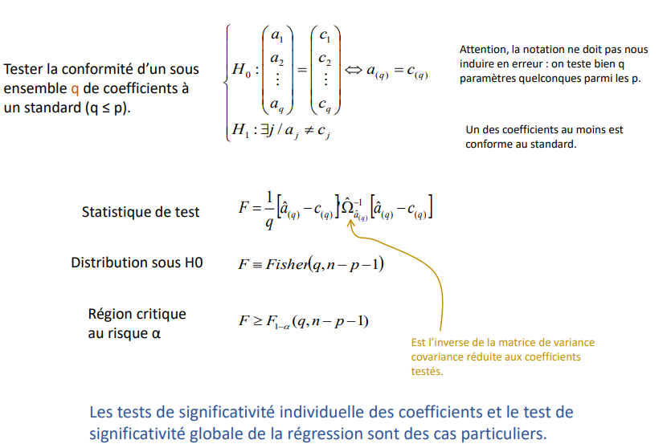
Conformity test Can be used to test the simultaneous nullity of several coefficients
Multiple Linear Regression
Be careful, the notation should not mislead us mislead us: we test q any parameters among the p.
At least one of the coefficients is conforms to the standard.
Testing the conformity of a subset q of coefficients to a standard (q ≤ p).
Test Statistics
Distribution under H0
Critical region at risk α
Is the inverse of the variance matrix covariance matrix reduced to the coefficients tested.
The tests of individual significance of the coefficients and the test of global significance of the regression are special cases. significance of the regression are special cases.

Slide 30
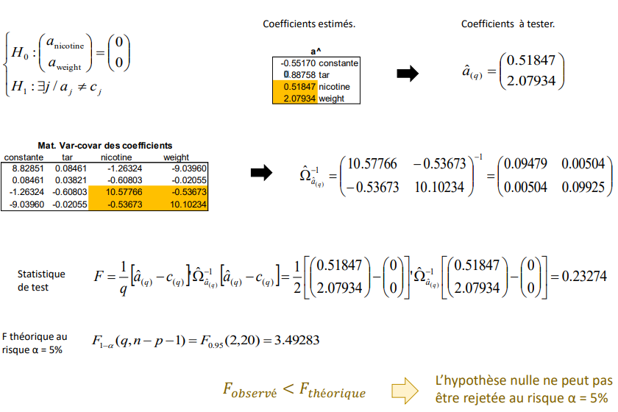
Example " Cigarettes " Test the simultaneous nullity of the coefficients of WEIGHT and NICOTINE (which individually are not significant...)
Multiple Linear Regression
Estimated coefficients.
Coefficients to be tested.
Mat. Var-covar of coefficients
Statistics test statistic
F theoretical at risk α = 5%
The null hypothesis cannot be rejected at risk α = 5%.
Observed
Theoretical

Slide 31
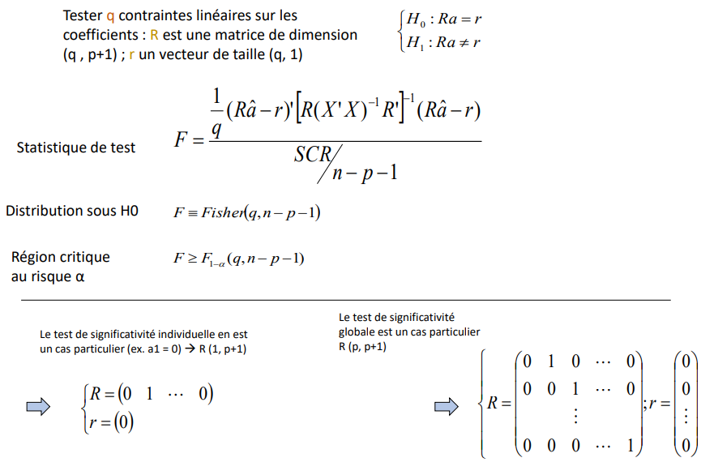
Test of "q" linear constraints on the coefficients Can be used to compare coefficients
Multiple Linear Regression
Test q linear constraints on the coefficients: R is a matrix of dimension (q , p+1) ; r is a vector of size (q, 1)
Test statistics
Distribution under H0
Critical region at risk α
The individual significance test is a special case of this a particular case (e.g., a1 = 0) R (1, p+1)
The test of global significance is a special case R (p, p+1)

Slide 32
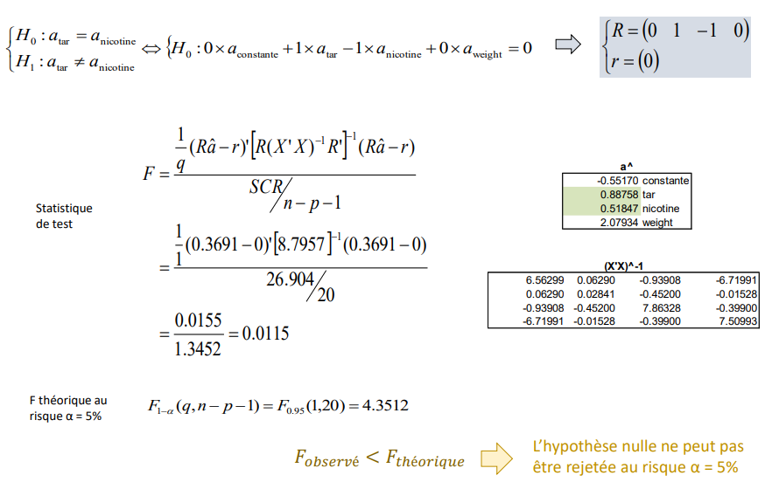
Example "Cigarettes” Test the equality of the coefficients of TAR and NICOTINE
Multiple Linear Regression
Statistics of test
F theoretical at risk α = 5%
The null hypothesis cannot be be rejected at risk α = 5%.
Observed
Theoretical

Slide 33
Prediction and prediction interval
Multiple Linear Regression

Slide 34
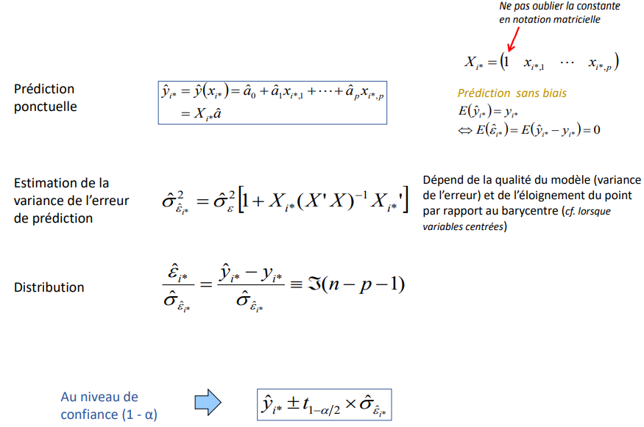
Prediction Point prediction and prediction interval
Multiple Linear Regression
Do not forget the constant in matrix notation
Point Prediction
Unbiased prediction
Estimation of the variance of the prediction error
Depends on the quality of the model (variance of the error) and the distance of the point from the barycentre (see when centred variables)
Distribution
At the level of confidence level (1 - α)

Slide 35
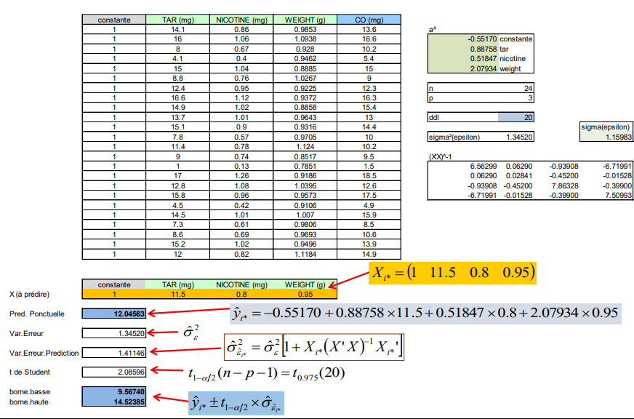
Prediction - Example "cigarettes Point prediction and prediction interval
Multiple Linear Regression
X (to be predicted)
Pred. Punctual
Var.Error
Var.Error.Prediction
Student’s t
low.bound
high.bound

